Slide 1
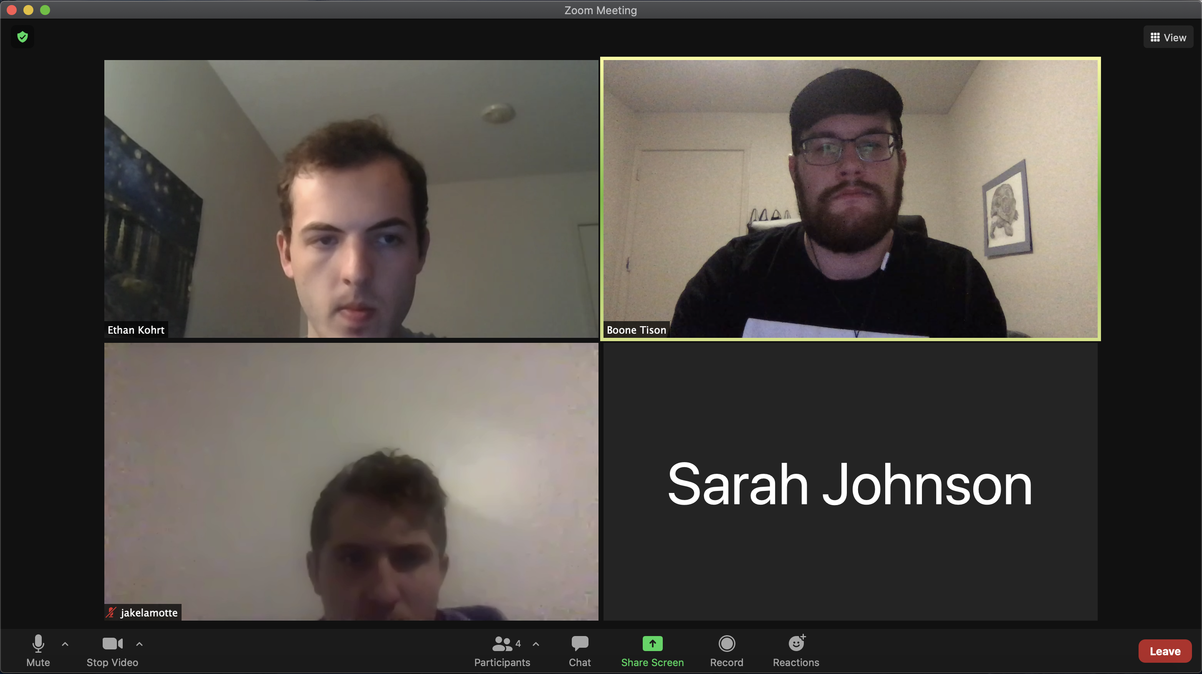

Games
Notes:
In zoom room

Slide 2
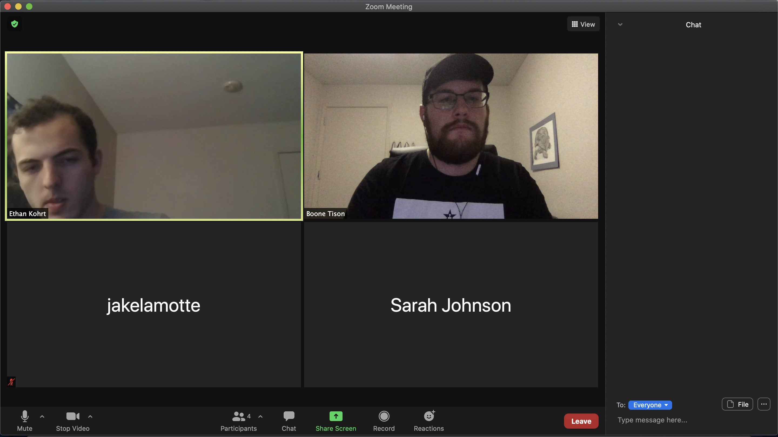
Games
Select Game:
Slither.io
Games
Notes:
Open game menu

Slide 3
Games
Select Game:
Slither.io
Slither.io Settings
5 Minute Time Limit
Invite Players
Invite All Participants in Call
Choose Participants:
Ethan Kohrt
Jake LaMotte
Sarah Johnson
SEND INVITES
Games
Notes:
Settings, prefer to set time or select participants, too difficult

Slide 4
Games
Select Game:
Slither.io
Slither.io Settings
5 Minute Time Limit
Invite Players
Invite All Participants in Call
Choose Participants:
Ethan Kohrt
Jake LaMotte
Sarah Johnson
SEND INVITES
Games

Slide 5
Games
Select Game:
Slither.io
Slither.io Settings
5 Minute Time Limit
Invite Players
Invite All Participants in Call
Choose Participants:
Ethan Kohrt
Jake LaMotte
Sarah Johnson
SEND INVITES
Games

Slide 6
Games
Select Game:
Slither.io
Slither.io Settings
5 Minute Time Limit
Invite Players
Invite All Participants in Call
Choose Participants:
Ethan Kohrt
Jake LaMotte
Sarah Johnson
SEND INVITES
Games

Slide 7
Games
Player Invites
Response:
Ethan Kohrt - Pending
Jake LaMotte - Pending
Sarah Johnson - Pending
START GAME
Games
Notes:
Invite sent

Slide 8
Games
Player Invites
Response:
Ethan Kohrt - Accepted
Jake LaMotte - Accepted
Sarah Johnson - Declined
START GAME
Games
Notes:
Invite accepted

Slide 9
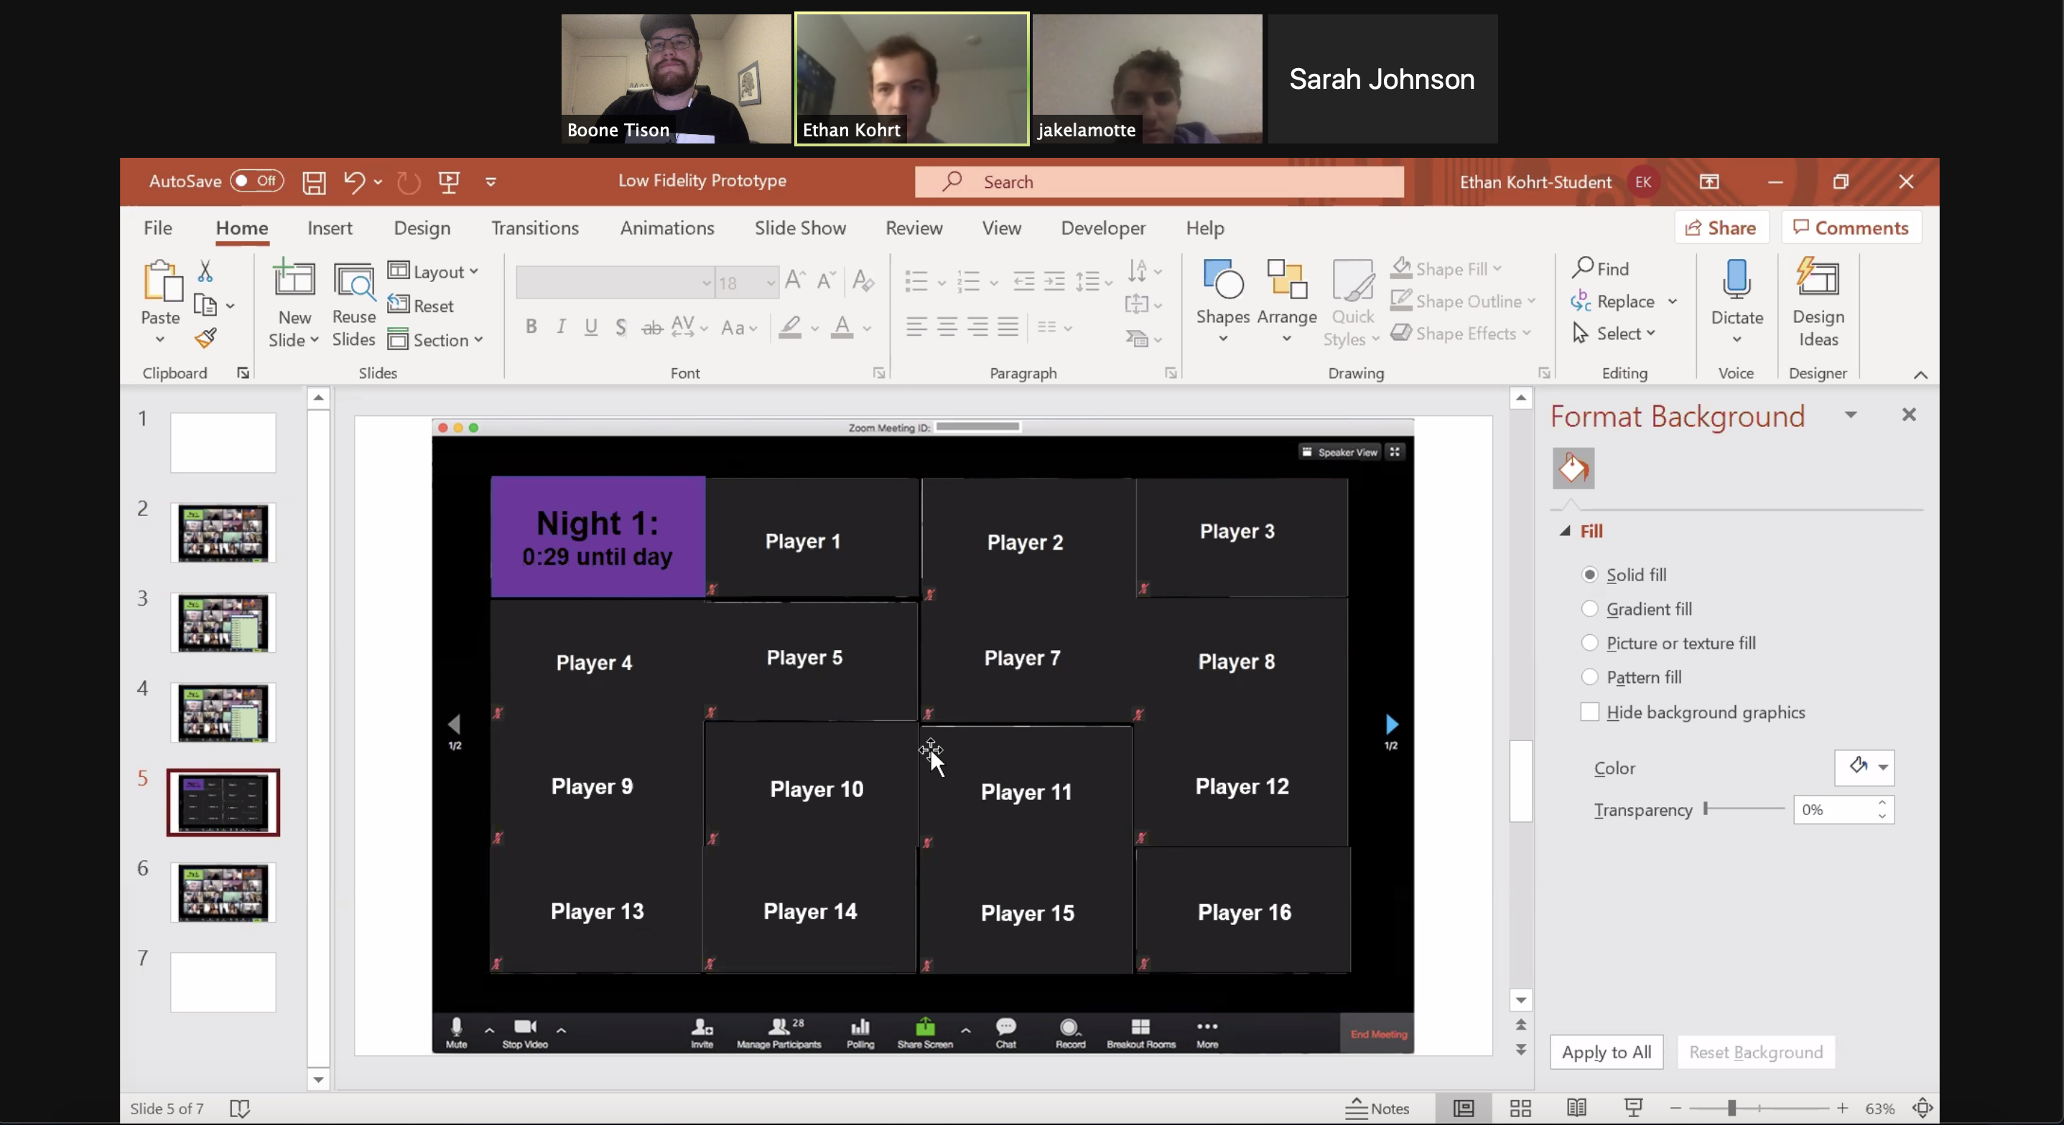

Notes:
Start game

Slide 10
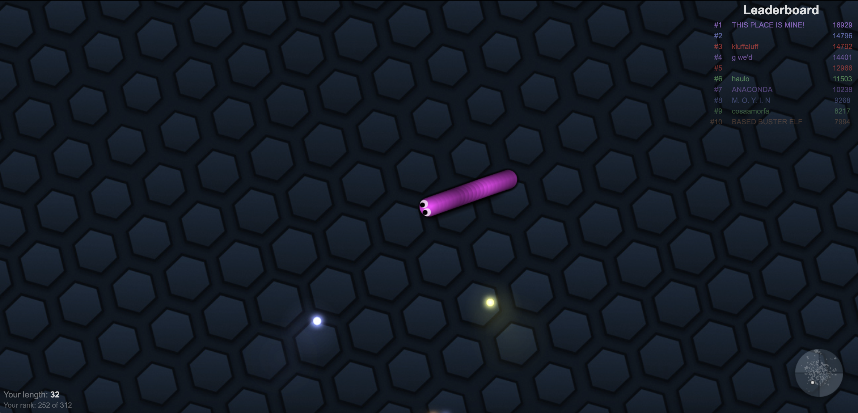
#1 Jake 78
#2 Boone 72
#3 Ethan 62
2 of 2
Notes:
Game in play

Slide 11

LEADERBOARD
#1 Ethan 128
#2 Jake 97
#3 Boone 96
LEAVE GAME
Notes:
End of game

Slide 12
Games
Notes:
In zoom room

